Slide 1
Office 2007
Overview
Kathy Woodcock
Conway High School West
Conway, AR
woodcock@conwayschools.net

Slide 2
Office Button
Quick Access Toolbar
Ribbon
  Tabs
  Groups
  Dialog Box Launcher
Screen tips
Gallery
Live Preview
Contextual tab
Mini toolbar
Saving
Global Changes

Slide 3
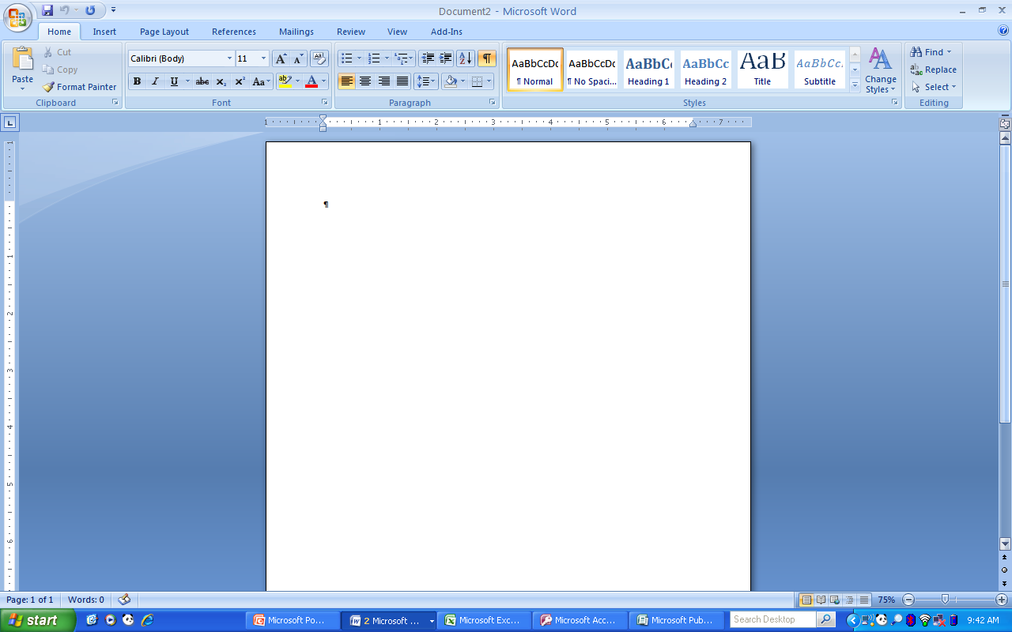
Defaults
Status bar—word count
Views
New Document dialog box
Tabs
Graphics—SmartArt

Slide 4
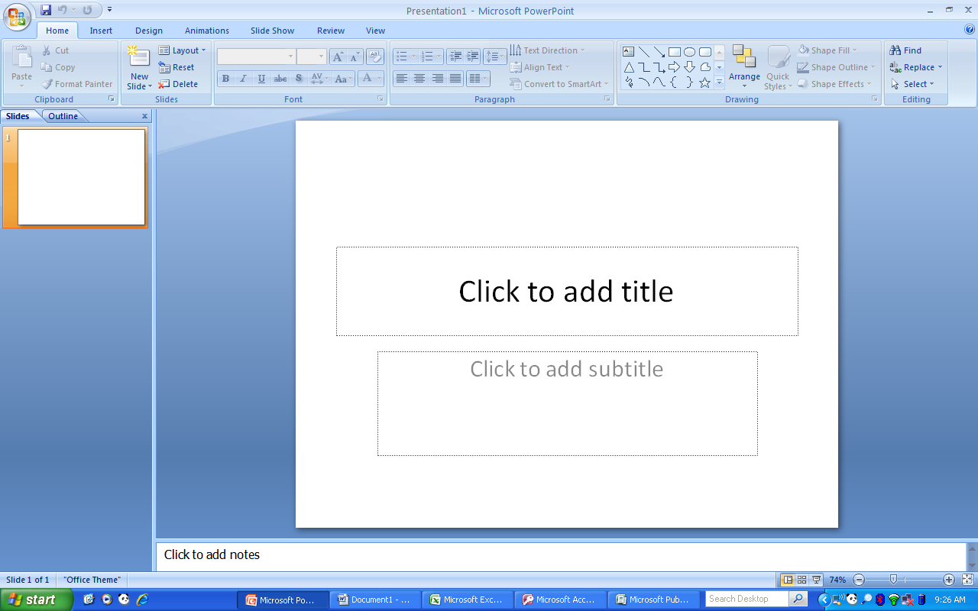
Design Tab
Animation Tab

Slide 5
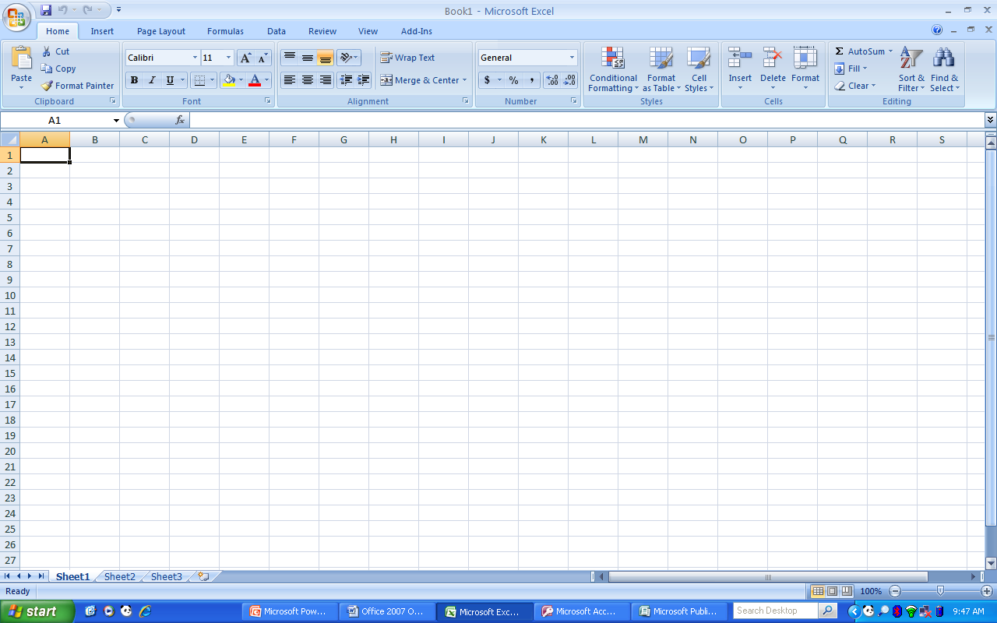
Default
Formula Ribbon
Data Ribbon
Resizing
Wrap text
Font and fill colors
Styles
Functions
Charts

Slide 6
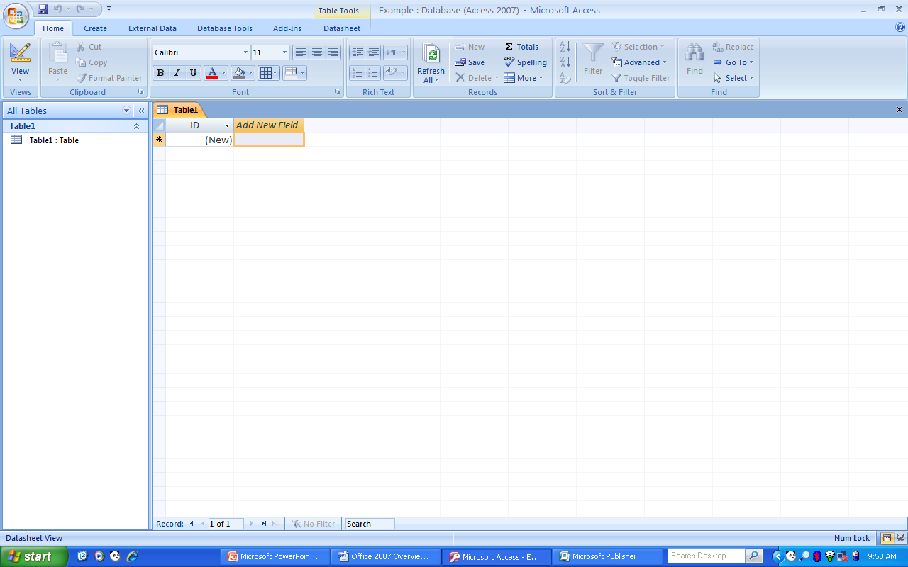
Navigation pane
Object tabs

Slide 7
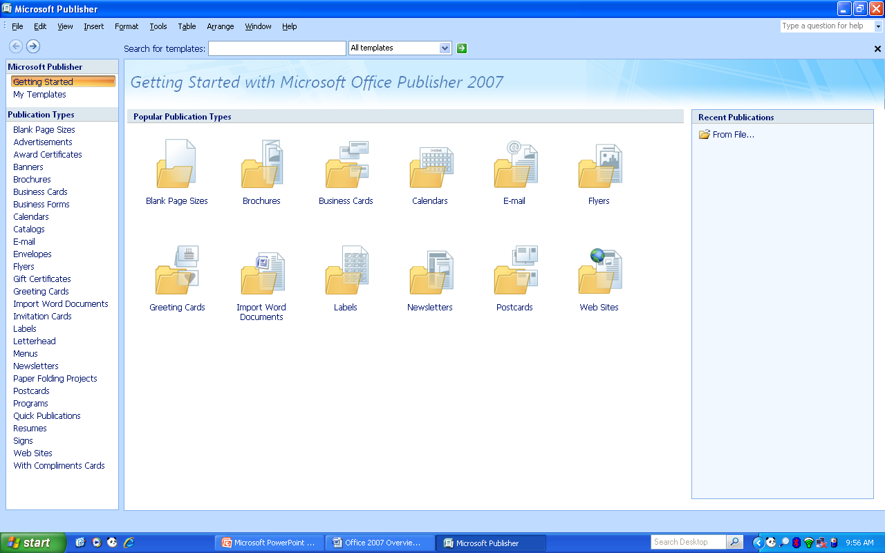
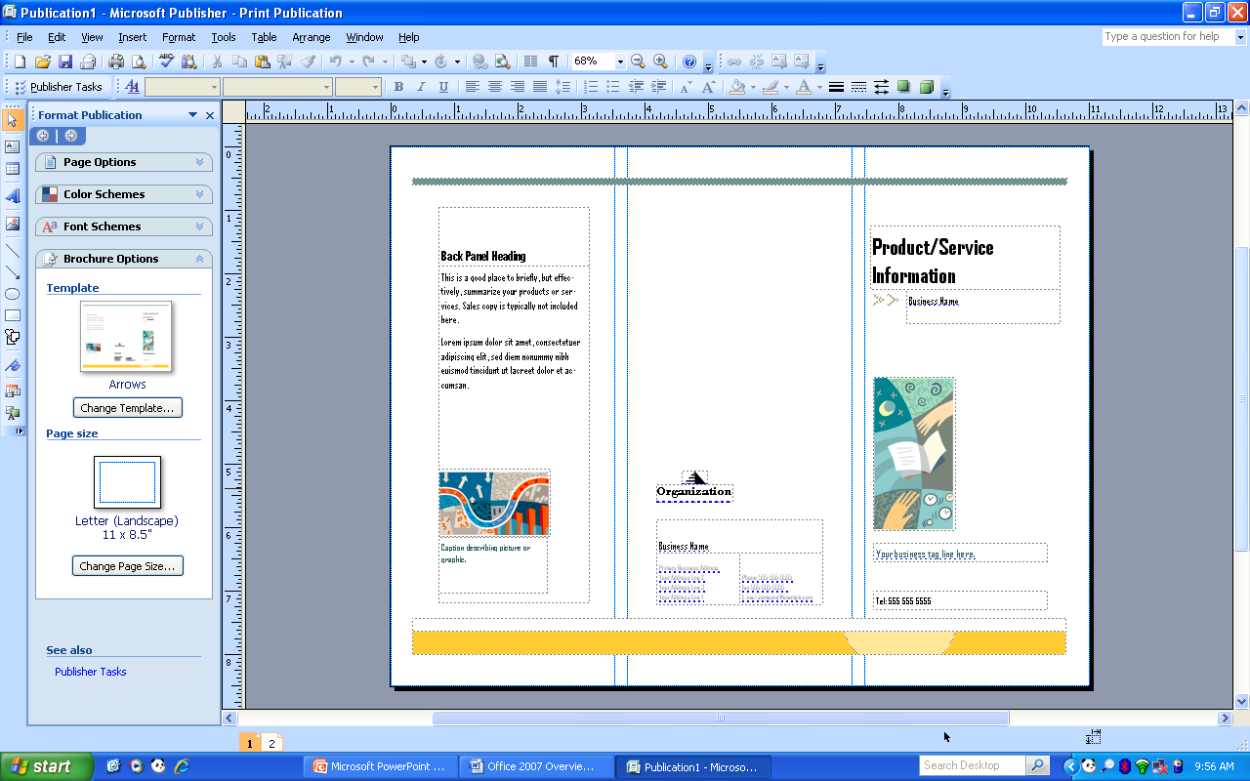
Opening Screen

